Slide 1
File: A file represents a sequence of bytes on disk where a group of related data is stored. File is created for permanent storage of data.
Types of Files: There are two types of Files.
1. Text Files : Consists of lines of characters
2. Binary Files: Binary Files stores floating point data.
There are different file organizations occurs in the file handling.
1. Sequential File access
2. Random Access Files

Slide 2
Sequential File Access: In this type, data are kept sequential. If we want to read the last record of the file, then we need to read all the records before the last record.
Random Access Files: In this type, data can be read and modified randomly. It takes less time as compared to sequential file.
File Operations in C
The processing of files has number of operations according to the user’s requirement. There are three file operations in C.
1. Opening File.
2. Reading/Writing data from/to File
3. Closing File.

Slide 3

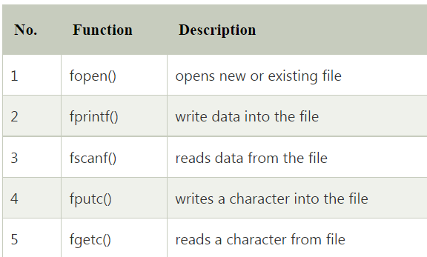

Slide 4
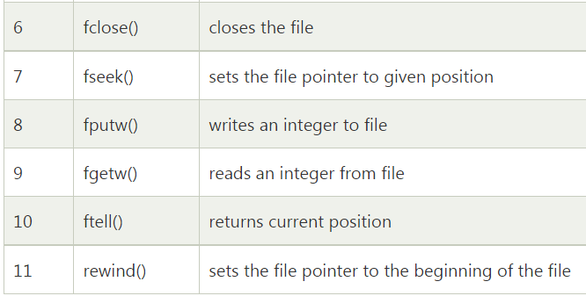

Slide 5
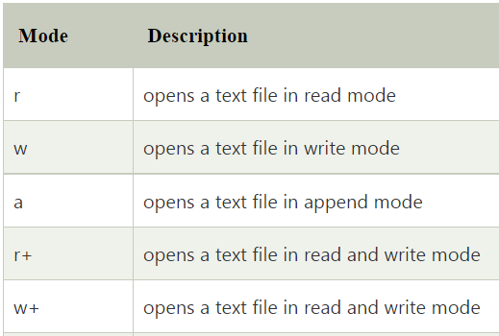
Modes of Files

Slide 6
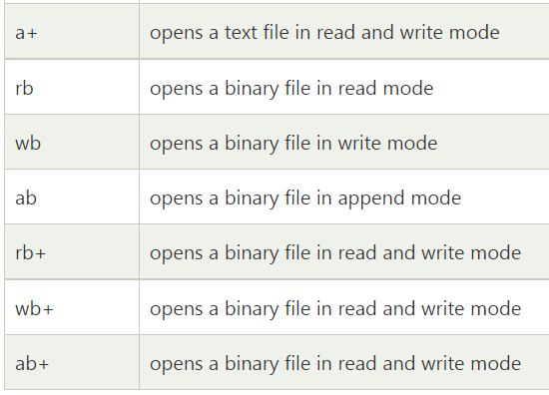

Slide 7
fopen()
Fopen() function is used to create a new file (or) open an existing file.
The fopen() function has two arguments
1. filename
2. mode
Syntax:
File pointer = fopen(“filename” , “ Mode”);

Slide 8
fclose()
Fclose() function is used to close particular file.
The fopen() function has one arguments
1. filepointer
Syntax:
fclose(filepointer);

Slide 9
fprintf()
fprintf() function is used to write set of characters into newly created file.
The fopen() function has two arguments
1. filepointer
2. string
Syntax:
fprintf(filepointer, ” content of file (or) string”);

Slide 10
fscanf()
fscanf() function is used to read set of characters from file. It reads word
By word and return EOF , at the end of the file.
The fopen() function has three arguments
1. filepointer
2. format specifier
3. string name
Syntax:
fscanf(filepointer,format specifier,string);

Slide 11
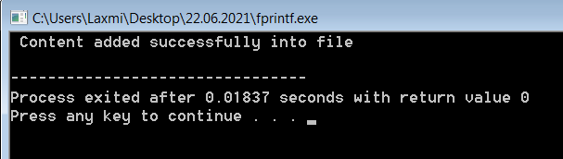
Example program for fprintf():-
#include<stdio.h>
void main()
{
FILE *fp;
fp=fopen("sample.txt","w");
fprintf(fp,"Hello User this is my first file in c please save the content");
printf(" Content added successfully into file \n");
fclose(fp);
}
Output:
Now open and see sample.txt

Slide 12
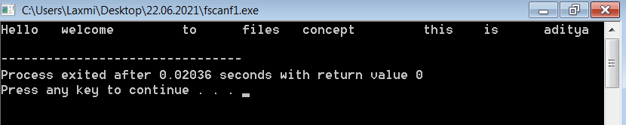
Example program for fscanf():-
#include<stdio.h>
void main()
{
FILE *fp;
char ch[1000];
fp=fopen("sample1.txt","r");
while(fscanf(fp,"%s",ch)!=EOF)
{
printf("%s \t",ch);
}
fclose(fp);
}
Output:

Slide 13
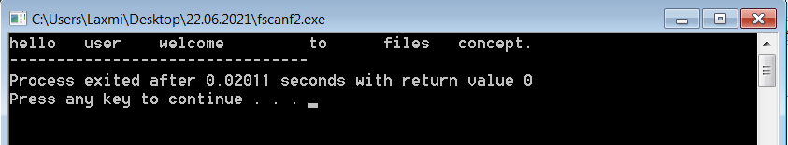
Example program for fscanf() ( File In different location ):-
#include<stdio.h>
void main()
{
FILE *fp;
char ch[1000];
fp=fopen("D:/Alice Blue/sample.txt","r");
while(fscanf(fp,"%s",ch)!=EOF)
{
printf("%s \t",ch);
}
fclose(fp);
}
Output:

